Slide 1
Learning Assessment Committee Update
08/22/2016

Slide 2
Professional Development
Assessment Workshop 101 – piloted and implemented
Amy Trogan, Donald Ransford, Myra Walters, Katie Paschall, Joseph van Gaalen, Eileen DeLuca
Engendering "Truth-Seeking" Dispositions in General Education
Jane Charles and Eileen DeLuca
Ciphering and Decoding: Quantitative Reasoning Can Be Fun!
Kristi Moran
Quantitative Reasoning in Non-STEM and STEM Courses
Don Ransford

Slide 3
Professional Development
Uncovering the Capabilities of the FSW Student
Joe van Gaalen
Connecting the Classroom to Careers
James Stewart, Joe van Gaalen
Developing Effective Research Assignment Guidelines
Scott Ortolano, Cynthia Enslen, Amy Trogan, Arenthia Herren, Joseph van Gaalen

Slide 4
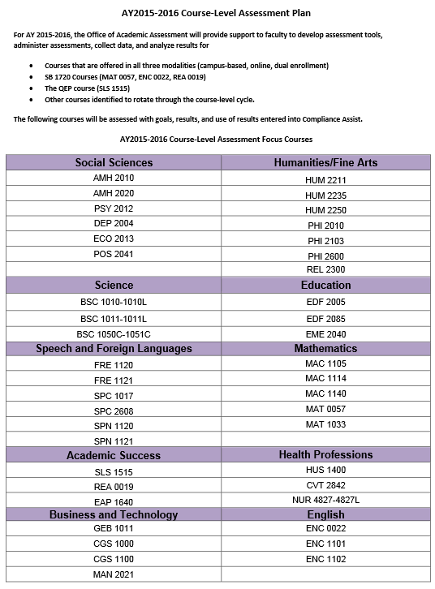

Slide 5
General Education
59 assignments volunteered by FSW faculty for assessment spanning 17 disciplines and encompassing 903 individual artifacts both written and oral.
All college locations (Charlotte, Collier, Hendry-Glades, and Thomas Edison {Lee}) represented in the study as well as FSW Online and Offsite locations (dual enrollment).
12 volunteers serving in six scoring groups scored a sample of 290 artifacts (32% of total artifacts).
Fernando Mayoral, Barbara Miley, Anjali Misra, Colleen Moore, Katie Paschall, Donald Ransford, Eric Seelau, Amy Trogan, Melanie Ulrich, Richard Worch, Joseph van Gaalen, Eileen DeLuca

Slide 6
Get Involved and Stay Connected
Assessment 101 Workshop
Online and Self-Paced
LAC Newsletter
Office of Academic Assessment Webpage
http://www.fsw.edu/facultystaff/assessment
Department Course Level Reports
General Education
LAC Newsletter Archive
Twitter
https://twitter.com/fswassessment

Slide 7
2016-2017 Initiatives
Continuity of the committee
Mentoring new members and assessment coordinators
Professional Development
Adding new opportunities
General Education Program
Develop a plan for the upcoming year
Refining collection process
Many opportunities for faculty to serve (College Service)
General Education Program Revision
Communicate the status to faculty members

