Slide 1
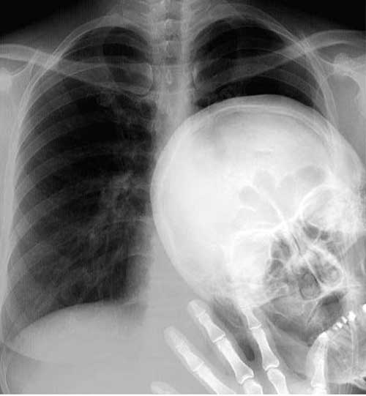
Welcome to the World of Radiography
Class of 2024-2026

Slide 2
Introductions & Attendance
Jim Mayhew, Program Director
Coleen Kubetschek, Clinical Coordinator
David Ingram, Lab Instructor
Mike McNiskin, Lab Instructor
Sara Cardenas, Clinical Associate
Tamra Pacheco, Instructional Assistant

Slide 3

Todays Schedule
9:00 – 9:30 Introductions
9:30 - 10:00 Alexis Augustenborg (Advisor)
10:00 - 10:30 Tamra Pacheco
10:30-12:30 PowerPoint
12:30 - ??? Questions

Slide 4
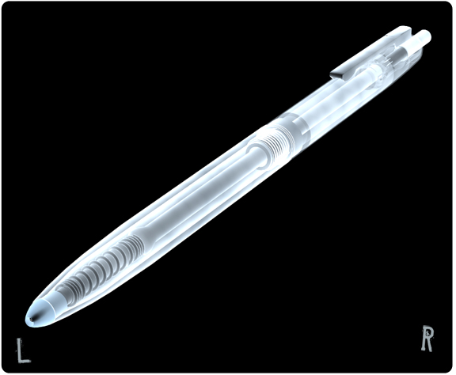
Forms to fill out.
These will be emailed to you.
Student Information page
  Initials, dob…
Informed consent
Statement of confidentiality (HIIPA)
Handbook Acknowledgement

Slide 9
The following forms MUST be completed and returned/uploaded by
July 5, 2024
The following must be uploaded to CastleBranch:
  Informed Consent
  Statement of Confidentiality
  Handbook Acknowledgement
Be very familiar with the Student Handbook which is located on the FSW Radiologic Technology web page

Slide 10
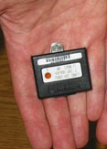

Lead anatomical side markers and a radiation monitor will be ordered for you
The monitor is for student time at clinic and must be kept at the site

Slide 11
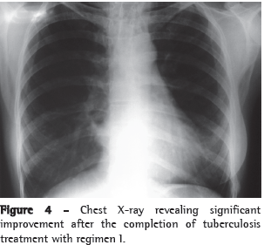
Health Report
Complete and upload to CastleBranch by July 12th
Yearly:
Background check, drug screen
Flu shot
A TB test is required every
year you are in the program

Slide 12
Personal Medical Insurance
You must have current medical insurance coverage
If your name is not shown on the insurance card you must have a “declaration of insurance” showing your name
Personal medical insurance must be maintained for the entire two years of the program

Slide 13
Castlebranch
Keep info current
DO NOT ignore their emails
Use code: ED12

Slide 14
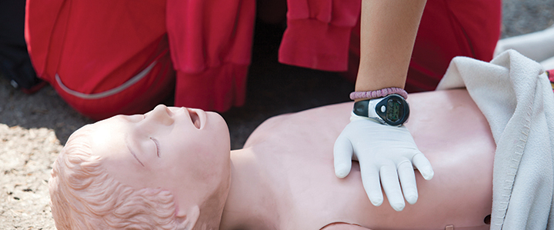
CPR
Must be American Heart Association- Healthcare Provider/ Category C
You must upload a current CPR card to your CastleBranch account by July 12th
https://www.fsw.edu/corporatetraining/aha
Notes:
Jim ems dates

Slide 15
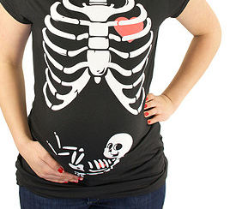
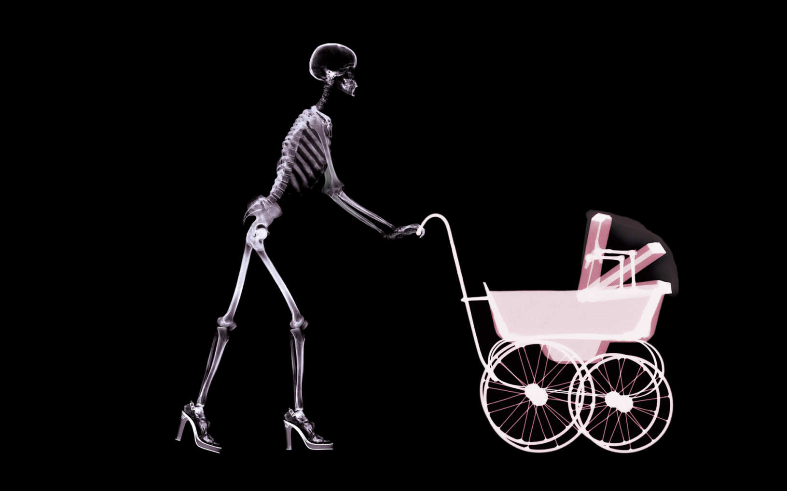
Pregnancy Policy
Notes:
Put in form

Slide 16
a. A student who is pregnant, or suspects she is pregnant, has the option of whether or not to declare her pregnancy to program officials. If she chooses to inform the officials of her pregnancy, it must be done in writing and indicate the expected date of delivery, and she has the option of un-declaring her pregnancy at any time. This withdrawal of declaration must be done in writing and given to the Program Director. Notification of the change in her health status facilitates the program’s policies concerning pregnant students (see the Pregnancy Counseling Sheet). If she chooses not to inform the program officials, she will be treated no differently than other students.
b. Following the student’s declaration of pregnancy, the RSO will review the Nuclear Regulatory Commission Regulatory Guide 8.13 with her. The RSO will also review the Pregnancy Counseling Sheet with the student and she will sign the document indicating that she understands the concepts of the policy.
c. The Program Director will review the student’s options concerning her continuation within the program. These options include: (a) continuation of the program without interruption, (b) withdrawal from the program and re-entering it at the beginning of the next semester in which her unfinished courses are offered, and (c) receiving a limited leave of absence. If a limited leave of absence is requested, it must be in writing and approved by the faculty.
d. The student may, by request, have her rotations altered during her first trimester to minimize exposure to the fetus. These changes are not mandatory and must be requested by the student in writing.

Slide 17
Important Organizations
National Certification Examination
  American Registry of Radiologic Technologists (ARRT)
  arrt.org
Florida State License
  Florida Department of Health
  https://www.floridahealth.gov/licensing-and-regulation/radiologic-technology/index.html
Program Accreditation
  Joint Review Committee on Education in Radiologic Technology (JRCERT)
  jrcert.org
National Professional Society
  American Society of Radiologic Technology (ASRT)
  asrt.org

Slide 18

Class information
All classes are held here on the Lee Campus in A-141
Days and times vary by semester

Slide 19
Registering for Classes
RTE 1000 Section 101
RTE 1001 Section 101
RTE 1418 Section 101
RTE 1503 Section 101
RTE 1503L Sections 100, 101, 102, or 103
RTE 1804 Section 101 (Clinical Internship)
Don’t choose campus when enrolling.
You must enroll in all classes at one time.
For RTE 1804, don’t look at site or times.

Slide 20

What books to buy
Principles of Rad Exposure I
  BUSHONG: RADIOLOGIC SCIENCE FOR TECHNOLOGISTS
Radiographic Terminology:
  LEONARD: QUICK & EASY MEDICAL TERMINOLOGY
Intro & Patient Care:
  EHRLICH : PATIENT CARE IN RADIOGRAPHY
Radiographic Position class and lab: ***Required text***
  FRANK: MERRILL'S ATLAS OF RADIOGRAPHIC POSITIONING AND PROCEDURES
  (3 volume set)
Recommended text:
  FRANK: MERRILL'S POCKET GUIDE TO RADIOGRAPHY
Recommended text:
  FRANK: MERRILL'S ATLAS OF RADIOGRAPHIC POSITIONING AND PROCEDURES (WORKBOOK)
Use the FSW Bookstore to check for current edition
https://www.fsw.edu/bookstore

Slide 21
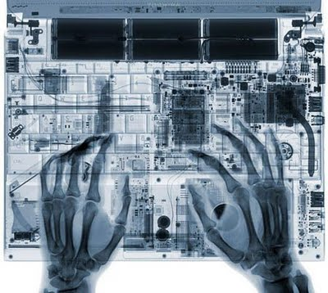
All other class material is on Canvas: syllabi, class schedule, power points, handouts, etc.

Slide 22
Trajecsys system
www.Trajecsys.com
Register and pay for an account
If your name is “joe smith” make your user name “jsmith”
Chose your own password
Use your Bucs FSW e-mail address
After setting up your account, you will receive an e-mail from Trajecsys to confirm your e-mail address
You will use Trajecsys to clock in at your clinical site

Slide 23
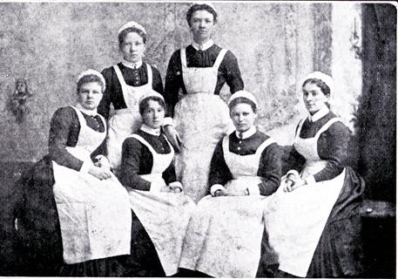
Uniforms
Available at the FSW Bookstore
Purple top(tunic or polo) and black pants
You should buy AT LEAST two sets
Black shoes

Slide 24
Dress Code continued
All visible tattoos must be cleared by the Clinical Coordinator
Piercings (excluding 1 pair of earrings) must be removed
Cologne/Perfume must not be strong
Hair must be pulled back and off your shoulders
Facial hair trimmed close to the face
Jewelry must be minimal; one pair of earrings one necklace…see dress code in handbook

Slide 25
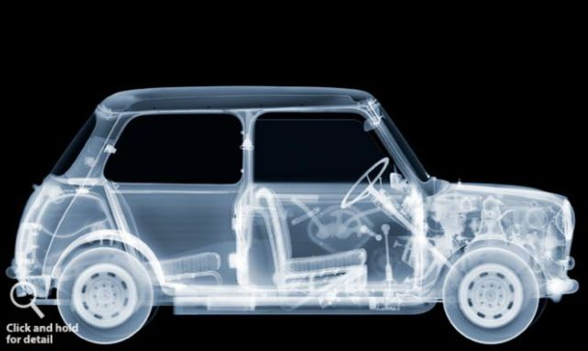
You will be driving A LOT throughout your two years in the program

Slide 26
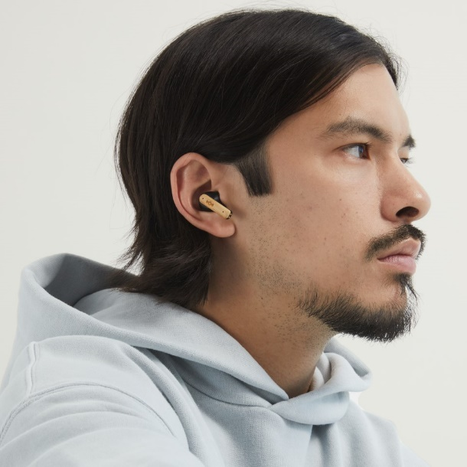
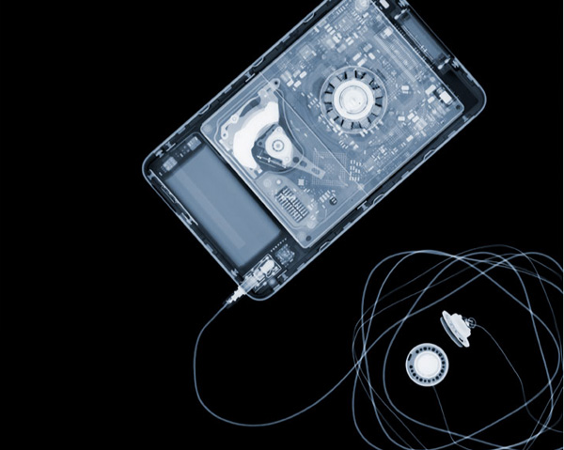
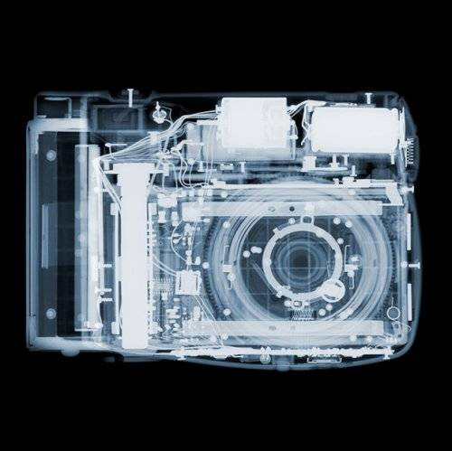
Electronic Devices
Cell phones must not be utilized in the clinical setting and they must be on mute and concealed at all times.
Ear buds must not be used during clinical hours.
No photographs can be taken at the clinical sites unless approved by the Clinical Instructor.

Slide 27
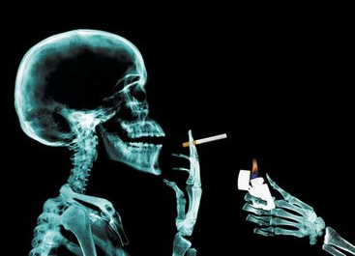
Smoking & Vaping is not allowed at any clinical site or anywhere on our campus

Slide 28
Grading for class and clinic
Class grading scale
93 to 100 A
85 to 92 B
75 to 84 C
Below 75 F
Clinical grading scale
96 to 100 A
91 to 95 B
85 to 90 C
Below 85 F

Slide 29
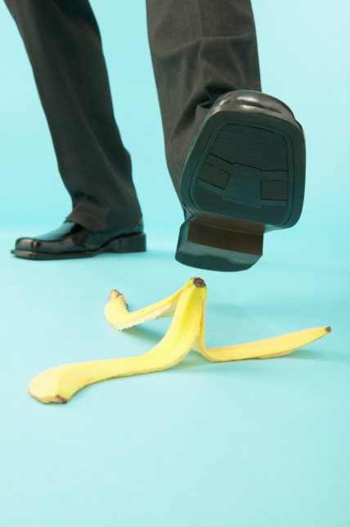
Student Accident Insurance
Covers accidents that occur on campus or in the performance of your clinical duties
It is not health insurance

Slide 30
If you have a change in your criminal background or health report while you are in the program please notify the Program Director immediately.

Slide 31

FSW Facebook page
Group: FSW Radiologic Technology Program
Closed Group
https://www.facebook.com/groups/1672365816312501/
Great place to look for job opportunities

Slide 32
Do not message or “friend” program administration, faculty, or Clinical Instructors on Facebook or other social media.
All e-mail must go through the FSW e-mail system
Check your FSW e-mail daily

Slide 33
The first Wednesday and Friday of Clinic will be held on campus.
A schedule will be given to you during the first week of class.
First clinical day will be August 28th.

Slide 34


Deadlines
Are just that…the LAST day something is due

Slide 35
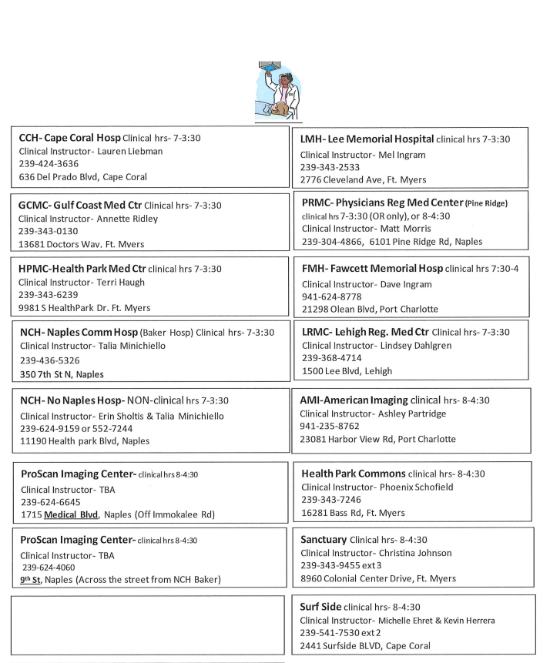

Slide 36
Clinical Assignments
And
Orientation Material

