Slide 1

Development of the APRT – Education, Credentialing and Clinical Practice
2024 Suncoast Pulmonary Symposium
Sarah Varekojis, PhD, RRT, RRT-ACCS, FNAP, FAARC

Slide 2
Objectives
To describe the progression of the advanced practice respiratory therapist (APRT) as a new profession.
To describe curricular development considerations for an APRT education program.
To describe career development progression for APRT clinical practice.
Notes:
The AARC, NBRC and CoARC have been working for many years on the development of a new professional and career advancement opportunity for respiratory therapists – the Advanced Practice Respiratory Therapist (APRT). This presentation will describe resources available to facilitate the process of establishing interest and need for an APRT, describe resources available to facilitate curriculum development for an APRT educational program, and describe current efforts around credentialing, licensing, and employing APRTs.

Slide 3
Disclosures
Board member and President of Commission on Accreditation for Respiratory Care (CoARC)
CoARC representative to the AARC APRT Taskforce
“The opinions expressed here are the personal opinions of Sarah Varekojis. Content published here is not read or approved by the Commission on Accreditation for Respiratory Care (CoARC) or the American Association for Respiratory Care (AARC) and does not necessarily represent the views and opinions of CoARC or AARC.”
Notes:
Currently serve as the DCE for the APRT education program at The Ohio State University.

Slide 4
APRT is a NEW
profession…
Notes:
I have started almost all of my presentations related to the APRT with this statement…
**
It is so important that we are all on the same page as we begin this discussion.

Slide 5
APRT
Builds on BSRT/RRT background to develop an advanced practice professional uniquely prepared to care for cardio-pulmonary patient needs
Establishes a clinical ladder for RRT/RCPs
Requires a Master’s Degree or higher in Respiratory Therapy
Provides patient services under the supervision and responsibility of a licensed physician
Not an RRT/RCP practicing at the top of his/her scope
Notes:
While the term “advanced practice” has been used in the past to describe a respiratory therapist that has progressed beyond entry-level, I want to be clear I am talking about a respiratory therapist that has completed additional graduate education that prepares them to assess, diagnose, and manage patient problems, to order tests, and to prescribe medications. The graduate education prepares them to function as an advanced practice provider.
The APRT…

Slide 6



Definition
From the AARC, CoARC, NBRC APRT Taskforce:
AARC.org; Select Your RT Career
Notes:
I mentioned earlier that the AARC, CoARC, NBRC APRT Taskforce has been working on developing the APRT for many years. The AARC hosts a website that describes some of the results of this committee’s efforts – this is the perfect place to start your exploration of APRT, whether you just want to learn more or are interested in developing or supporting a new APRT program.
Several times during this presentation I will provide QR codes that will link you to a resource. If you open the camera on your phone and move the QR code into the frame, you should receive a message you can click on to open the website. If you are unable to get the QR code to work, I will also provide the basic path to find the resource. For example, you can get to the AARC APRT website by navigating to aarc.org, then clicking on the Your RT Career link close to the top of the page, then select the APRT link.

Slide 7
Definition
AARC, CoARC, NBRC APRT Taskforce
The Advanced Practice Respiratory Therapist (APRT) is a trained, credentialed, and licensed respiratory care practitioner who is employed to provide a scope of practice that exceeds that of the Registered Respiratory Therapist.
After obtaining the NBRC RRT credential, the aspiring APRT must successfully complete a CoARC-accredited APRT graduate-level education and training program that provides a curricular emphasis that enables the APRT to provide evidence-based, complex diagnostic and therapeutic clinical practice and disease management.
Notes:
One of the things you can find on this website is the definition of an APRT.
**
This definition includes many of the essential elements we have already discussed regarding this new profession. I want to just quickly mention that I am aware that there are other graduate programs available to respiratory therapists. However, the focus of those programs is on leadership, management, education, and/or research, and not on advanced clinical practice per the definition we just read. It is exciting that a few of these programs are CoARC accredited as Degree Advancement programs, and there are currently 9 CoARC-accredited entry-to-practice programs that are at the Master’s level. Again these are not APRT programs even though they award a Master’s degree. APRT programs are a combination of degree and curriculum considerations.

Slide 8
Definition
No plans to make any changes to current RRT scope of practice.
Notes:
I think it is also important to note that during our committee meetings, there has been no discussion of plans to make changes to the current RRT scope of practice. Please understand that the focus of all these efforts has been on the development of a new profession, not a reduction or an expansion of the current scope of practice for an RRT.

Slide 9
Definition
An advanced practice respiratory therapist (APRT) is a skilled person, qualified by academic and clinical education to provide diagnosis and treatment of respiratory diseases and disorders to patients under the supervision and responsibility of a
licensed doctor of medicine or osteopathy.
Notes:
Provide diagnosis and treatment of respiratory diseases and disorders

Slide 10
Scope of Practice
An APRT may perform any services authorized by the supervising physician that are within the normal course of practice and expertise of the supervising physician. The APRT may be involved in care of the patients of the supervising physician in any medical setting for which the physician is responsible. The APRT’s scope of practice is determined primarily by physicians and the APRT at the practice level which allows for a flexible and customized team function based on the needs of the practice setting.
Notes:
May be involved in care of patients in any medical setting, and scope of practice should meet the needs of the setting.

Slide 11
Scope of Practice
An APRT may perform medical acts, tasks, or functions in accordance with state licensing laws that are:
Related to the care of persons with problems affecting the cardiovascular and/or cardiopulmonary systems;
Delegated by a supervising physician to an APRT;
Within the scope of practice identified in collaboration with the supervising physician;
Appropriate to the APRT’s education, experience, and level of competence; and
Related to the prescribing, ordering, procuring, dispensing, and administering of drugs, medical care, and medical devices related to the cardiovascular and/or cardiopulmonary systems.
Notes:
This national scope of practice is an important resource for programs working on establishing need for and interest in an APRT program, but is also a key resource for state societies working on developing APRT licensure. I will talk a little more about this again toward the end of the presentation, but I wanted to point out that this document has many important purposes as we pursue APRT implementation.

Slide 12



Resources
AARC, CoARC, NBRC APRT Taskforce
Developed a definition and model scope of practice
Commissioned 3rd party to conduct needs assessment with physicians
Pursuing direct billing and supporting states with APRT education and licensing
Identified gap in care for cardiopulmonary patients in the literature
Notes:
So the first task the AARC, CoARC and NBRC taskforce completed was developing a definition and scope of practice. Their next steps were related to establishing a need for and interest in APRTs. The committee has published 2 important manuscripts that you can use to start key conversations at your institutions.
I also want to point out very quickly that the committee is currently … [pursuing direct billing…] and more information about those activities will be coming soon.

Slide 13
Notes:
But back to establishing need and interest. Just a reminder that this resource is linked from the AARC Your RT Career APRT page
The first publication is from Chest. The authors conducted an exhaustive review of the existing literature to establish that … [first column]
They also discussed proposed potential solutions found it the literature and discovered that … [second column]
This publication sets the stage for the new APRT profession and for incorporating APRTs into the care team.

Slide 14
Notes:
The second publication is also linked from the AARC Your RT Career APRT page
The AARC commissioned a third-party to conduct a needs assessment with physicians whose practice includes a large portion of patients with cardiopulmonary disease. The results were published in Respiratory Care. The primary question was “Is there a current need for a NPAPP to care for patients with CPD”. Approximately 70% of … [stop after “RTs should be considered”]
These findings and conclusions solidify the establishment of the APRT as a new profession. I would encourage you to read the full texts of both of these publications to ensure you are prepared to introduce the APRT at your institution.

Slide 15

CoARC Standards
coarc.com
Accreditation, then Advanced Practice Standards
Accreditation Standards for APRT
Master’s degree or higher
Graduate of CoARC accredited program, baccalaureate degree, RRT credential, one year clinical practice…
Endorsed/Supported by AARC, ACCP, ATS, ASA
Notes:
Additional resources that have been developed to support the establishment of the APRT as a new profession include education program standards. Every profession needs to have standards to describe the education and training requirements necessary to become a member of the profession. I will get into lots of detail in a few minutes about the CoARC APRT standards, but for now please note that the standards dictate that graduates must earn a Master’s degree or higher and that applicants must have earned the RRT credential and have completed at least one year of clinical practice

Slide 16
Credentialing
NBRC formed “APRT Role Analysis” committee
Medical specialties
Other cardio-pulmonary APPs
Employers
Graduates
APRT Competency Exam outline and content
Notes:
Graduates of accredited education programs are customarily required to demonstrate competency to practice in the profession by successfully passing credentialing exams. And most licensing agencies require that individuals provide evidence of completion of an accredited education program and attainment of a recognized professional credential.
As you are well aware, the National Board for Respiratory Care manages and administers entry-to-practice and specialty credentials for respiratory therapists. They have been involved in the conversations about creating the APRT from the beginning, and have taken important first steps to developing an exam for the APRT. I will not go into lots of detail here, but part of the NBRC’s process to develop a new credentialing exam is to complete a job analysis survey. It will take a while to have enough practicing APRTs to conduct a job analysis, so the NBRC has moved forward with developing a competency exam for APRTs that educational programs, employers, and/or licensing boards can use to determine if an APRT graduate has demonstrated minimal competency to practice as an APRT. The NBRC formed an APRT role analysis committee that created and administered a survey to representatives from the relevant medical specialties, from advanced practice providers working in cardiopulmonary specialties, from current and future employers, and from APRT program graduates to explore the necessary knowledge, skills, and attributes of an APRT. The results of the role analysis survey will inform the development of an exam content outline and eventually a competency exam.

Slide 17
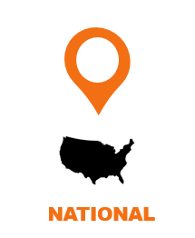

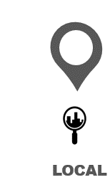
Notes:
All of the information presented in the last few minutes represent the foundational building blocks required to create a new professions. It is exciting to realize that we have what we need to make this a reality!
But there is still a lot of work to be done on a local level to implement the necessary elements of a new profession. So let’s transition the conversation from what has happened nationally to establishing the APRT in your state and local areas.

Slide 18


Notes:
As I mentioned earlier, I am the DCE for the APRT education program at The Ohio State University. I am going to tell you a little about our curricular development process. I can’t tell you how many times I have been part of the “which comes first?” conversation, but I am an educator, and we moved forward with the notion that you should start with what you know. I do want to point out that we did not move forward in isolation – we have been continually addressing education, employment, credentialing, and licensing with the necessary local individuals and groups as we moved forward.

Slide 19
Establishing support for APRT
Advisory committee and Medical Director
Clinical partners
Local/State needs assessment
Notes:
Whether you are an educator interested in developing an APRT program, an educator that has students and graduates that are interested in pursuing APRT as a career option, a current student or a practicing RT interested in applying to an APRT program, or a manager interested in employing APRTs at your facility, I believe the things I talk about regarding developing an education program will help you all realize that each of you play an important role, and that we need all of you to be actively engaged in the process.
How do you establish support for an APRT program?
If you are affiliated with an entry-to-practice program and/or a degree advancement program, you already have an Advisory Committee and may have a Medical Director. Use them as leverage and to generate momentum. Introduce the concept of an APRT program and gauge reaction and interest. You will likely have to do some education for the members to ensure they are informed and aware of the existing resources regarding scope of practice and need and interest. Provide examples of program graduates that have continued in a clinical career ladder that would have been able to continue in an APRT program if it had been available. Your Advisory Committee can be very influential with your Dean or Vice President – if communities of interest and program stakeholders express an interest in an APRT program and vow to provide support for clinical education and potential employment, this can be a very effective argument for program development.
It is likely you have representatives from your clinical partners on your advisory committee. Charge them with having conversations with their department’s Medical Director and other physician stakeholders at their facility to introduce the new profession and consider opportunities at their facilities. Encourage them to have conversations with hospital administrators about local and specific practice gaps an APRT could fill. Volunteer to attend the meetings with the committee members for support and to answer specific questions. It will take some of your time, but it will likely pay off in the end.
Collect some data specific to your state regarding the need for and interest in an APRT program. And I would encourage you to approach this from both the supply and the demand side. Ask students graduating from your state’s programs how likely they would be to enroll in an APRT program. And specifically ask several of your most recent graduating classes how likely they would be to return and enroll in an APRT program. Ask RT employers and department Medical Directors how likely they would be to employ an APRT. Deans and Vice Presidents need to see data that if you build it they will come, and that a new program will be sustainable.

Slide 20
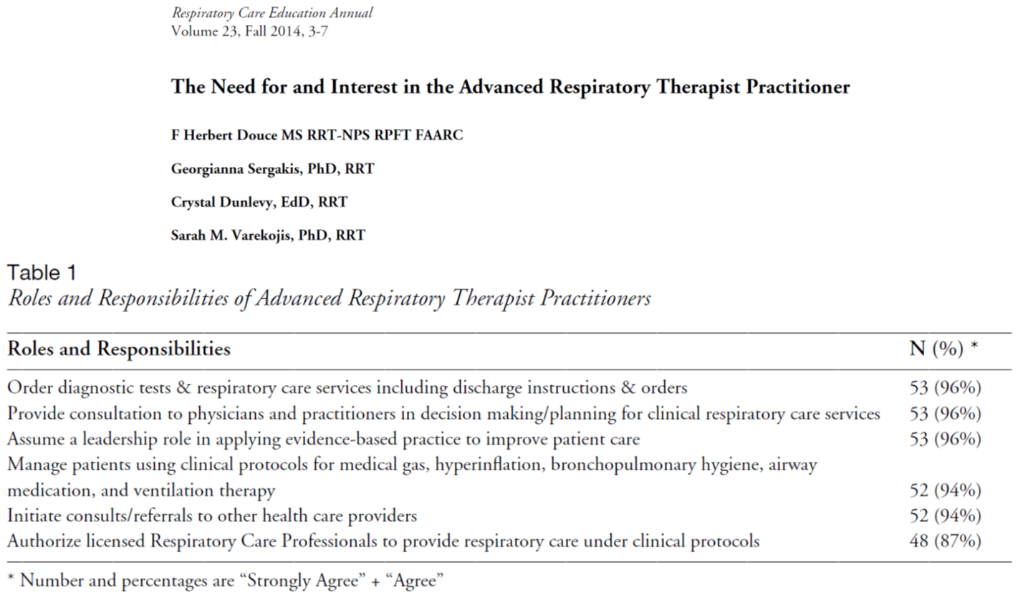

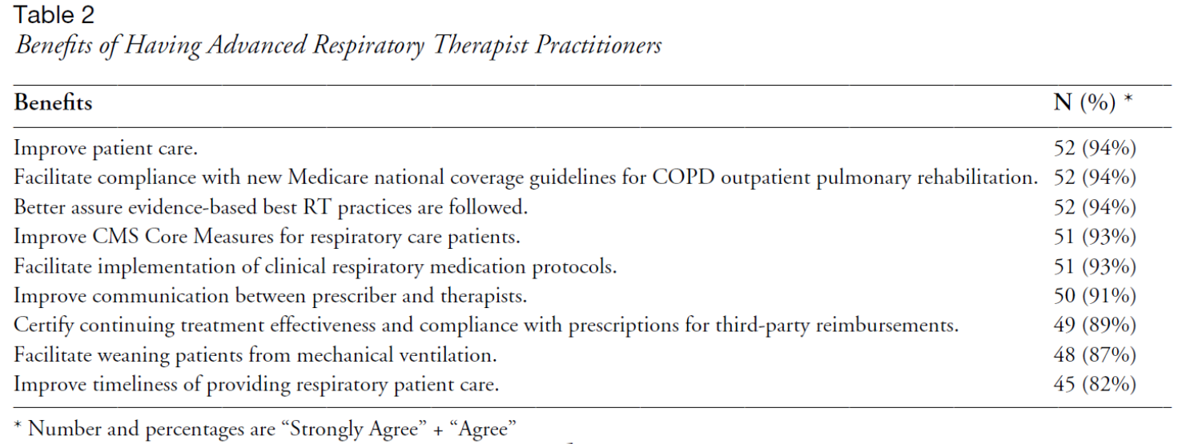
aarc.org;
Select Education & Resources, then For Educators
Notes:
My colleagues and I published an example of a state-wide needs assessment you could model in the 2014 Respiratory Care Education Annual. Please note this was conducted before the AARC, CoARC, NBRC taskforce created the definitions and scope of practice, and before CoARC published the APRT standards. As a result, some of the descriptions and roles and responsibilities would need to be updated to reflect the current literature. But the methods could be followed to gather your own local data to share with decision-makers.

Slide 21
Local Needs Assessment
Conclusions:
There is widespread need for an APRT in Ohio
There are significant expected benefits to patients and employers of APRTs
Informed the development of a degree proposal for the MRT graduate program at OSU
Results may support the need for graduate level educational programs for APRTs in other states

Slide 22
Graduate Education
Master’s Degrees
Science-based
Academic
Research-focused
Professional
Tagged
Career development
Master of Science
Master of Business Administration
Notes:
After you have the support necessary to move forward with the development of an educational program, there are several decisions that must be made before you get to a proposed curriculum. It will take some time and effort on your part to make sure you are informed and knowledgeable about the many steps necessary to move forward.
If you are involved in Graduate Education at your institution, you have a little bit of a head start. Graduate program governance is different and separate from undergraduate governance. It is likely that you will have to learn new processes and procedures for proposal and approval of an APRT program.
I need to pause for a minute and make sure I also point out that you need to make some decisions about the type of graduate degree you will be offering. I am going to use a Master’s degree example, because that is the route we went. But you would also have to make the same decision about a doctorate degree. Most Graduate Schools award the Master of Science degree to academic, science-based disciplines, and most specify a strong research component to the degree, including both research coursework and an independent research thesis. However, most Graduate Schools also award professional master’s degrees that focus on career development, like an MBA. Sometimes these are referred to as tagged Master’s degrees, as they are tagged to a certain field or profession. Our Graduate School offers both MS and professional master’s degrees.

Slide 23
Graduate Education
Master’s Degrees
Science-based
Academic
Research-focused
Professional
Tagged
Career development
Master of Science
Master of Business Administration
Master of Respiratory Therapy
Notes:
We had to decide which type of degree made the most sense for the APRT program, and we decided to pursue a tagged degree. We wanted to be able to focus on courses that would prepare the graduate for clinical career advancement, and all of the other health professions graduate degrees focused on clinical practice offered at our institution are tagged degrees (OT, PT, AT, Med Diet…).
The ODHE did not previously allow for a Master of Respiratory Therapy degree to be awarded, so we had to pursue approval at both the state level and at our institution. Approval for an MRT degree from the state was an additional challenge we had to address as the first program in our state to develop an APRT program, and created an additional learning curve for us as faculty.

Slide 24
Creating a new graduate program
School Curriculum Committee (2011)
School Graduate Studies Committee (2011)
College Educational Leadership
Graduate School Council
Council on Academic Affairs
University Senate
University Board of Trustees (2016)
Chancellor’s Council on Graduate Studies (2016)
Ohio Department of Higher Education (2017)
Notes:
A new degree proposal must be approved at your institution first, before being forwarded to the state for approval. For us, that meant starting by completing a new degree proposal following the ODHE guidelines for graduate programs. This proposal had to be approved by both the curriculum committee and the graduate studies committee within our School, and then had to be approved by our College educational leadership. After College approval, it had to be reviewed and approved by three Graduate School committees, before moving forward to the Council on Academic Affairs, University Senate, and eventually to the University’s Board of Trustees. The approval process at the state level involved submission of the proposal for the new degree by our Graduate School, review and feedback from other Graduate Schools across the state, presentation of the new degree proposal to the Chancellor's Committee on Graduate Studies and finally, a vote by the committee.
The good news is that now that the State of Ohio has approved the Master of Respiratory Therapy degree, other Colleges and Universities can follow their internal process for proposal and approval of new programs and will not have to also apply to the state for approval of a new degree.

Slide 25
CoARC Standards
coarc.com
Accreditation, then Advanced Practice Standards
Accreditation Standards for APRT
Master’s degree or higher
Graduate of CoARC accredited program, baccalaureate degree, RRT credential, one year clinical practice…
Endorsed/Supported by AARC, ACCP, ATS, ASA
Notes:
As you can imagine, part of the program proposal that had to be approved at all those levels was a proposed curriculum. The good news is that CoARC developed and published accreditation standards for APRT programs in 2016 and most recently updated in 2022.
I mentioned these Standards a few minutes ago as one of the resources you should explore for more information on APRT. Those of you that are affiliated with entry-to-practice and/or degree advancement programs are very familiar with CoARC’s standards for those programs. Specifically for the entry-to-practice standards, the curriculum section of the standards refers to including competencies necessary for practice as an RRT, and the standards are light on specifics. Programs can use the NBRC detailed content outlines for the TMC and the CSE to guide curriculum and course development to meet the standards.
Since the NBRC does not currently have a credentialing exam with a detailed content outline for the APRT, the standards for APRT programs look very different.

Slide 26
CoARC APRT Standards
Informed by APRT DACUM project
Respiratory Care Section of SCCM (Expert Panel)
“List all tasks, procedures and competencies needed for training an advanced-practice respiratory therapist to function as a pulmonary/critical care physician assistant.”
“Please rate each task or procedure in terms of importance for the training and practice of an advanced level respiratory therapist in order for him or her to function as a pulmonary/critical care physician’s assistant.”
~140/163 competencies with score of 3.5 or higher on 5 point Likert scale
Notes:
A little history about how the APRT program standards were developed since there is no detailed content outline to reference.
Drs. David Shelledy, David Vines and Jonathan Waugh worked with the Respiratory Care Section of the Society for Critical Care Medicine on a DACUM process to establish competencies necessary for an APRT. The 13 member expert panel was asked…
**

Slide 27
APRT Core Competencies
Respiratory Care Knowledge
Interpersonal and Communication Skills
Patient Care
Professionalism
Practice-based Learning and Improvement
Systems-based Practice
Inter-professional Practice
Notes:
The result of this project was the development of seven APRT Core Competencies that are incorporated into the AP standards.
**

Slide 28
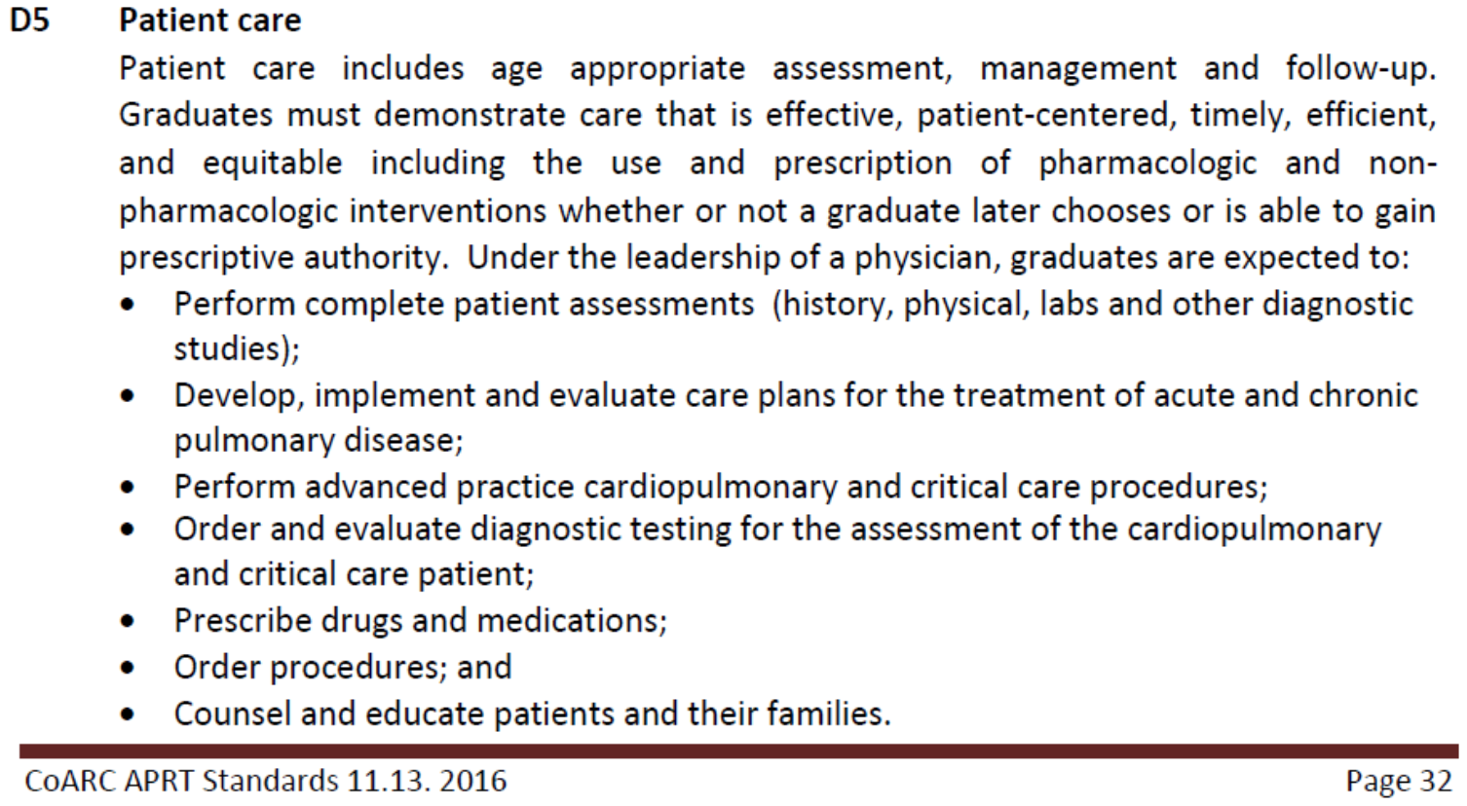
APRT Core Competencies
Notes:
I know you can’t read the details on these slides, but as examples, under respiratory care knowledge and patient care, you will find competencies like “Perform a problem-focused or complete history and physical examination as indicated, and obtain necessary diagnostic studies, including imaging, laboratory and procedural tests. Interpret clinical information and formulate a prioritized differential diagnosis that reflects the use of medical knowledge in a probabilistic reasoning process. Make appropriate clinical decisions based on the results of diagnostic testing. Manage specific general medical and surgical conditions to include understanding the indications, contraindications, side effects, interactions and adverse reactions of pharmacologic agents and other relevant treatment modalities.” And so much more! Hopefully you can see that the APRT curriculum is very different than the entry-to-practice RT curriculum, due to significantly different expectations for practice following graduation. The APRT curriculum builds on an entry-to-practice respiratory therapy curriculum to prepare the graduate to provide diagnosis and treatment of cardiopulmonary diseases and disorders to patients under the supervision of a physician.

Slide 29


Curriculum Development
Notes:
Using CoARC’s accreditation standards that specify content areas that must be included in an APRT curriculum, next we had to determine if that content was offered in an existing course on campus and if we could secure seats in those classes for the APRT students, how many new courses would we have to develop and did we have the faculty budget to support those new courses, how many credit hours did we need to offer in our division to support the needed faculty, how many lab hours were needed and how many clinical hours were needed… We also wanted to ensure our graduates would be able to prescribe if the practice act supported that function, so we had to explore existing statutes related to granting prescriptive authority for other advanced practice providers. We discovered that specific course content had to be included in the curriculum, so we sought opportunities to partner with the College of Nursing since they already offered a course that met the requirements as part of their APN curriculums. As part of that conversation we sought other opportunities for the ARPT students to complete foundational coursework with the APN students to further strengthen our curriculum. The APRT students enroll in coursework with APN students, with other health professions graduate degree students (PT, OT, PhD…), and they enroll in unique APRT courses developed specifically for this curriculum.

Slide 30
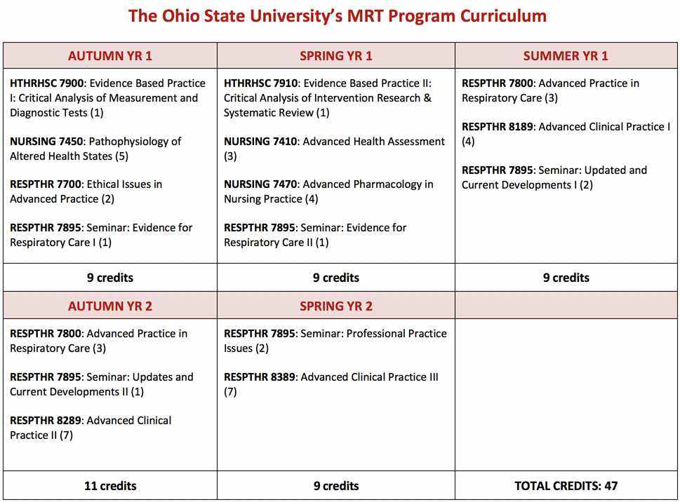

Slide 31


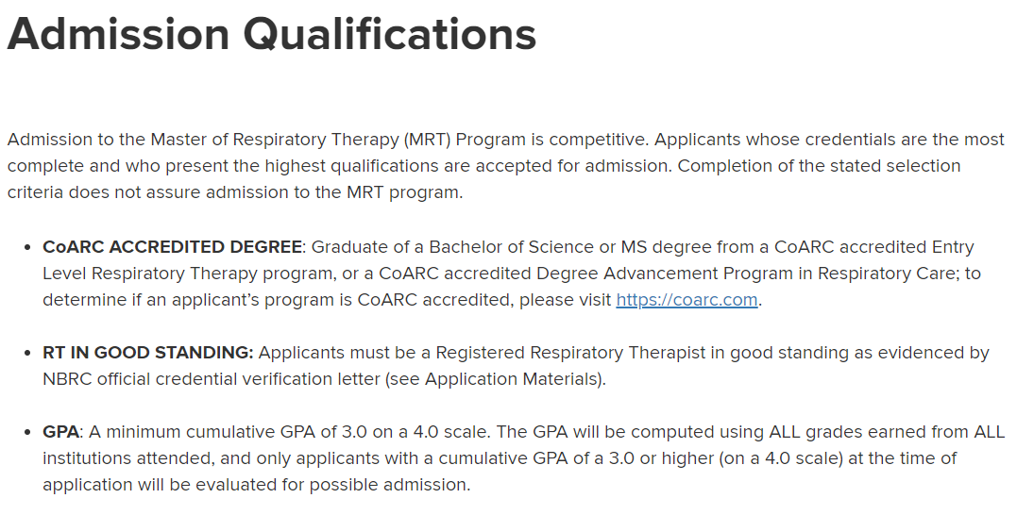
hrs.osu.edu;
Academics, then Graduate Programs

Slide 32
Academic and Clinical Expectations
Classroom
Laboratory
Simulation
Clinical
Full-time expectations
Notes:
We patterned our academic and clinical expectations after the other graduate level professional programs in our School. This means full time course work every semester for 2 years. This also means a combination of classroom, laboratory, simulation and clinical hours in any given semester. I think it is important to point out that an APRT program is not like an MBA or Master in Education degree where students are enrolled in didactic-only courses that can likely be taken in any order. In the APRT program, each semester is pre-requisite to the next, and since course work includes laboratory and clinical components, students will be engaged in course-related activities for many hours each week. Most RTs experienced a full time entry-to-practice curriculum, and the same level of commitment is expected in an APRT curriculum. APRT program faculty and students need to expect a significant time obligation to be able to accomplish the expectations included in the CoARC Standards and for future practice.

Slide 33
Academic and Clinical Expectations
Outpatient pulmonary, sleep, cystic fibrosis, BPD, other specialty clinics
Interventional pulmonology outpatient services and clinic
Inpatient pulmonary service, inpatient pulmonary consult service
Peri-operative services
Medical ICU, Surgical ICU, Pediatric ICU, Neonatal ICU
Notes:
Clinical rotation assignments include:
These were selected based on the CoARC Standards and based on physician leadership support in each respective area. Every student is expected to complete rotations in every clinical area. We plan to expand clinical rotation assignments as we are able, specifically incorporating rotations in the Cardio-Thoracic ICU. Our first several semesters occurred during the beginning of the COVID-19 pandemic, and while it made things significantly more challenging, it also highlighted the need for an APP with cardio-pulmonary expertise on a very local level. Because clinical supervision must be performed by physicians, asking them to include an APRT as another learner to mentor on their team through COVID was interesting, but nevertheless, we persisted.

Slide 34
CoARC approval
LOI to offer accredited APRT program approved by CoARC July 2019
Included clinical site affirmations from NCH, OSUWMC
Self-study submitted to CoARC September 2019
Site Visit completed November 2019
Provisional CoARC accreditation December 2019
Notes:
It took about 18 months from the time of degree approval from the ODHE to submission of a Letter of Intent to CoARC. This was when we were developing our curriculum and establishing our classroom, laboratory and clinical resources. The LOI must include clinical site affirmations indicating how much and what areas of clinical education the clinical partner can provide. Following approval of the LOI, we completed a self-study indicating how we planned to meet each of the APRT Standards. After CoARC referee review and approval of the self-study, an in-person site visit was scheduled. The site visitors met with faculty, advisory committee members, and academic leadership, they toured educational spaces, and they reviewed additional documents. Our site visitors and our program referee felt the proposed APRT program met standards and we received provisional accreditation in December of 2019. We were able to start enrolling students in January 2020.
Since then we have graduated three classes of students and are actively enrolling new students for a fall cohort.

Slide 35
Employment Expectations
Human Resources
Hospital Administration
Physician and Nursing Leadership
Notes:
One of our objectives is to discuss career development progress for the APRT. I already mentioned the NBRC competency exam that is in development. I want talk a little about employment and licensure for APRTs.
There are many people that need to be involved in developing employment opportunities for APRTs. And it is tempting to say “not it” as an educator. But I do have a vested interest in the employment success of my graduates. Remember, Deans and Vice Presidents want to know that a new education program will be sustainable, and part of that sustainability is employment post-graduation. CoARC also wants to know how satisfied employers are with your graduates. The good news is that the same members of your advisory committee that you worked with to establish support and develop clinical rotations can help initiate the conversations with HR, physician and nursing leadership and administrative leadership regarding employment opportunities. And we have found that HR is an important first stop – job codes, position descriptions and appropriate compensation models must be created so that those interested in hiring APRTs have something to use for proposals and budgeting. In addition, it is imperative to have conversations with administrative leadership surrounding likelihood of credentialing for the APRT. This is not a reference to national credentialing exams as are administered by the NBRC. All APPs must be credentialed at the hospital or health system where they work, and it is tied to specific roles in specific positions. For example, an APRT working in an acute care environment may need to be credentialed to perform thoracentesis, but an APRT working in an ambulatory environment may not need to be credentialed for that procedure. HR and administrative leadership will need to help guide the process of modification of medical staff bylaws, policies and procedures, and APP policies and procedures to incorporate the APRT. In parallel, your physician and nursing leadership needs to advocate for the inclusion of APRTs on their provider teams when having conversations with HR and administrative leadership. They need to be engaged from the beginning to ensure there is some gravity to your requests.

Slide 36
Employment Expectations
APRT
RT department
Outpatient clinic
Acute Care Unit
Inpatient Service
Notes:
I have also been part of conversations regarding whether the APRT will be employed by the RT department, or by a patient care unit, or by an ambulatory clinic. Woven throughout this conversation are discussions regarding billing, reimbursement and payment. This may mean involving billing and coding specialists to help determine which employment pathway makes the most sense. It is also important to note that our national scope of practice indicates that APRTs work under the supervision of a licensed physician and perform services delegated by this supervising physician. This must also be considered when determining the employment pattern.
Please note that I am talking about employment expectations from the perspective of both an adult and a pediatric academic medical center, as that is my experience. However, I believe most of this discussion is applicable to any circumstance, but some of the specifics may be a little different depending on your unique situation.

Slide 37
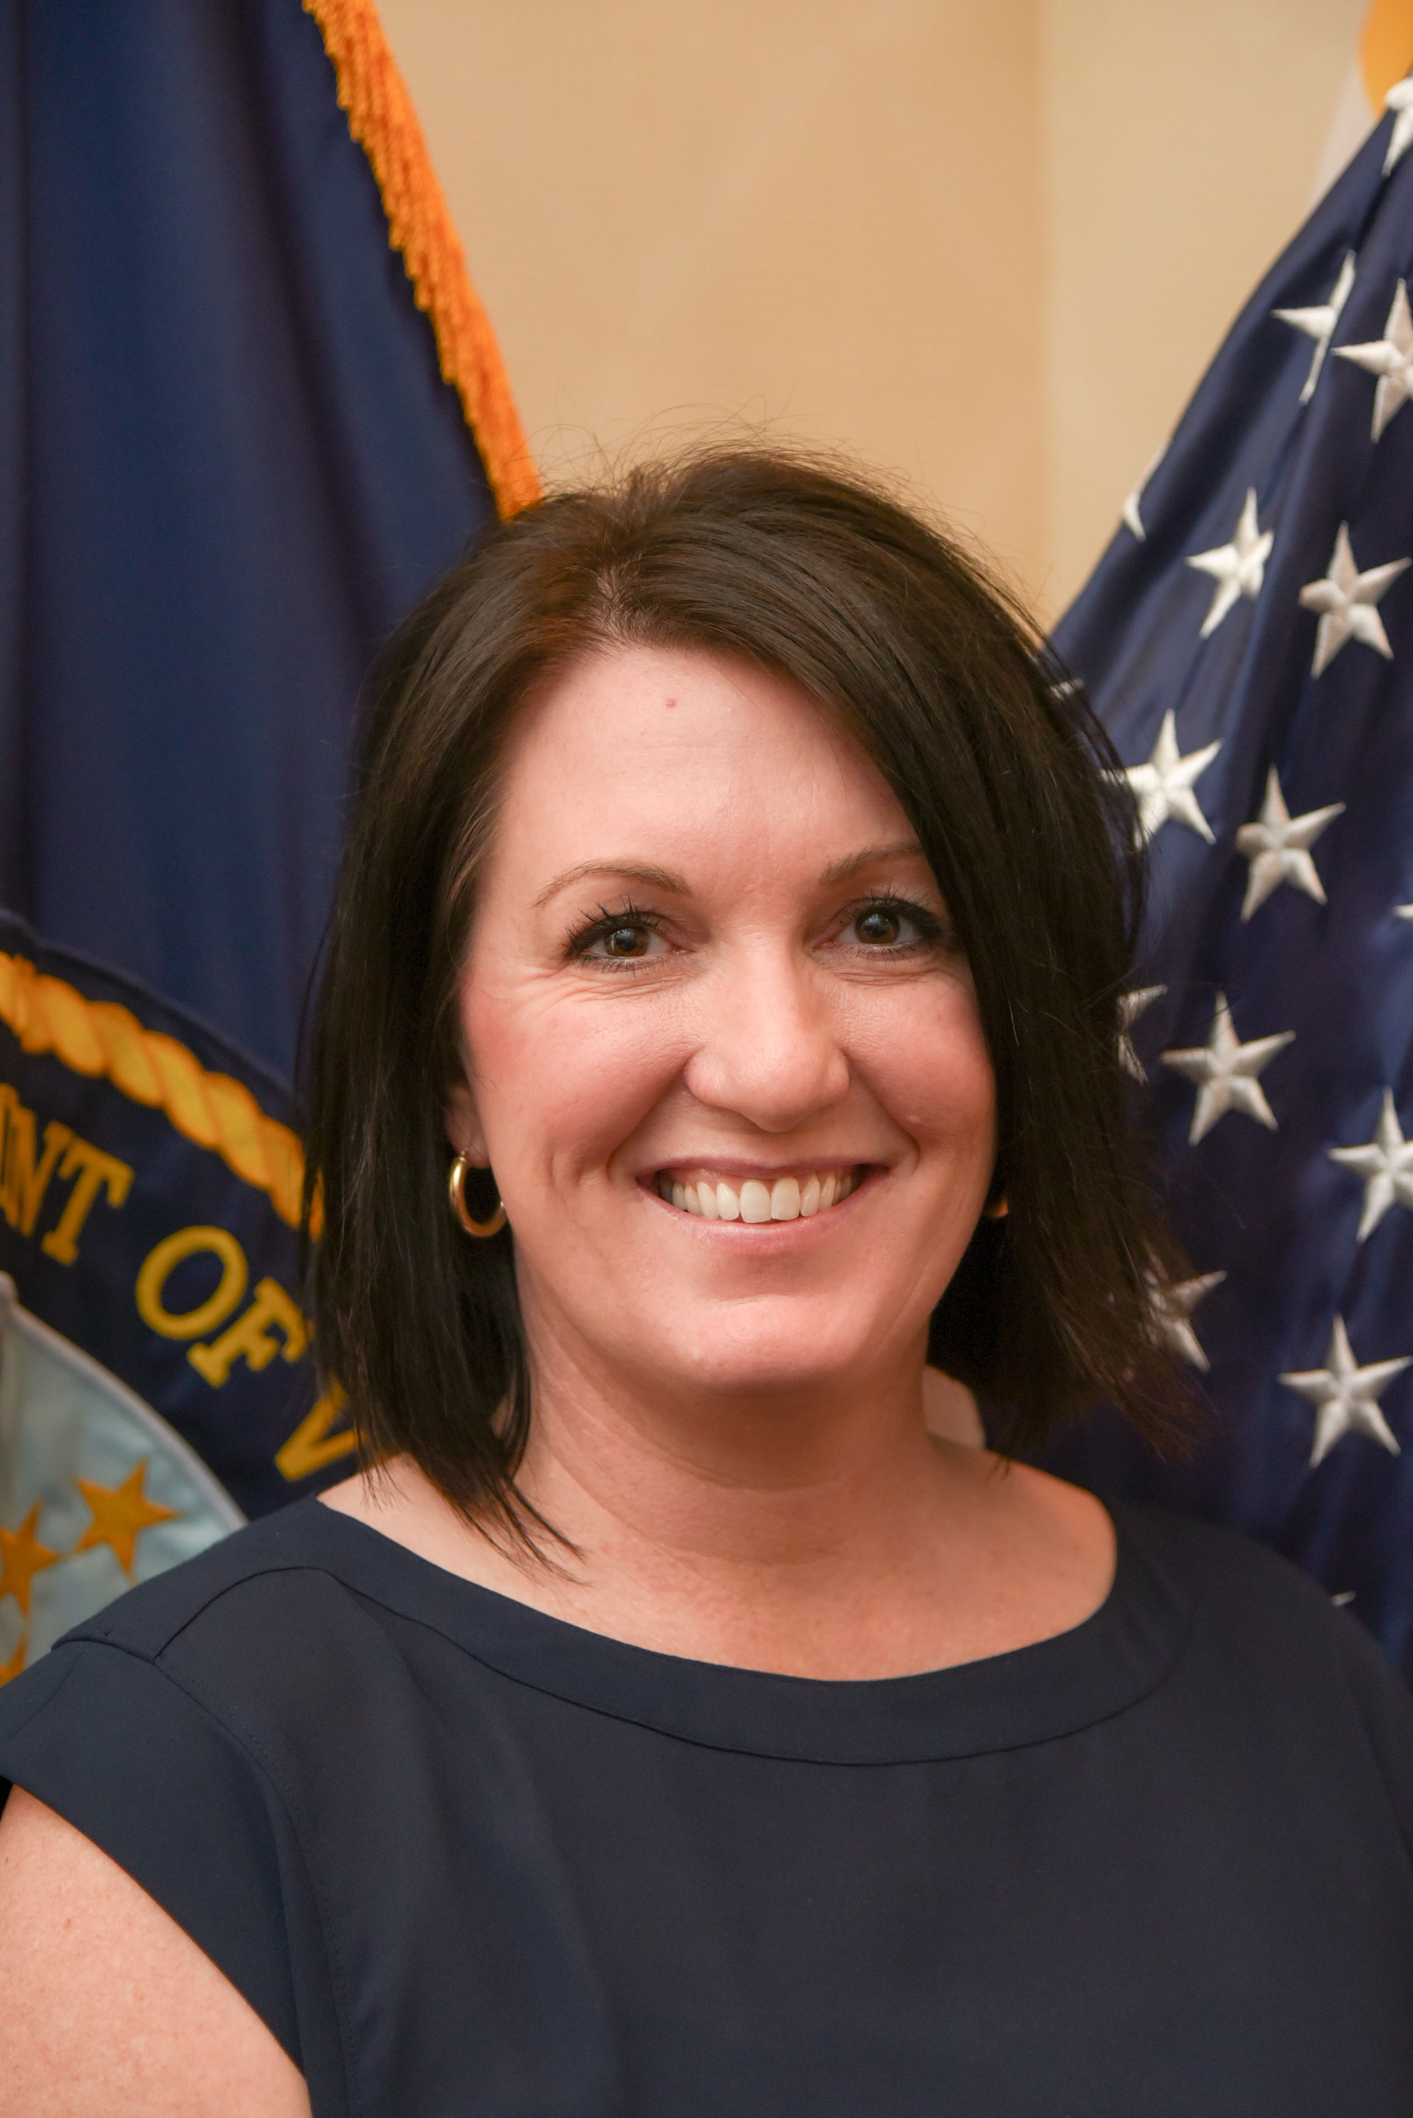
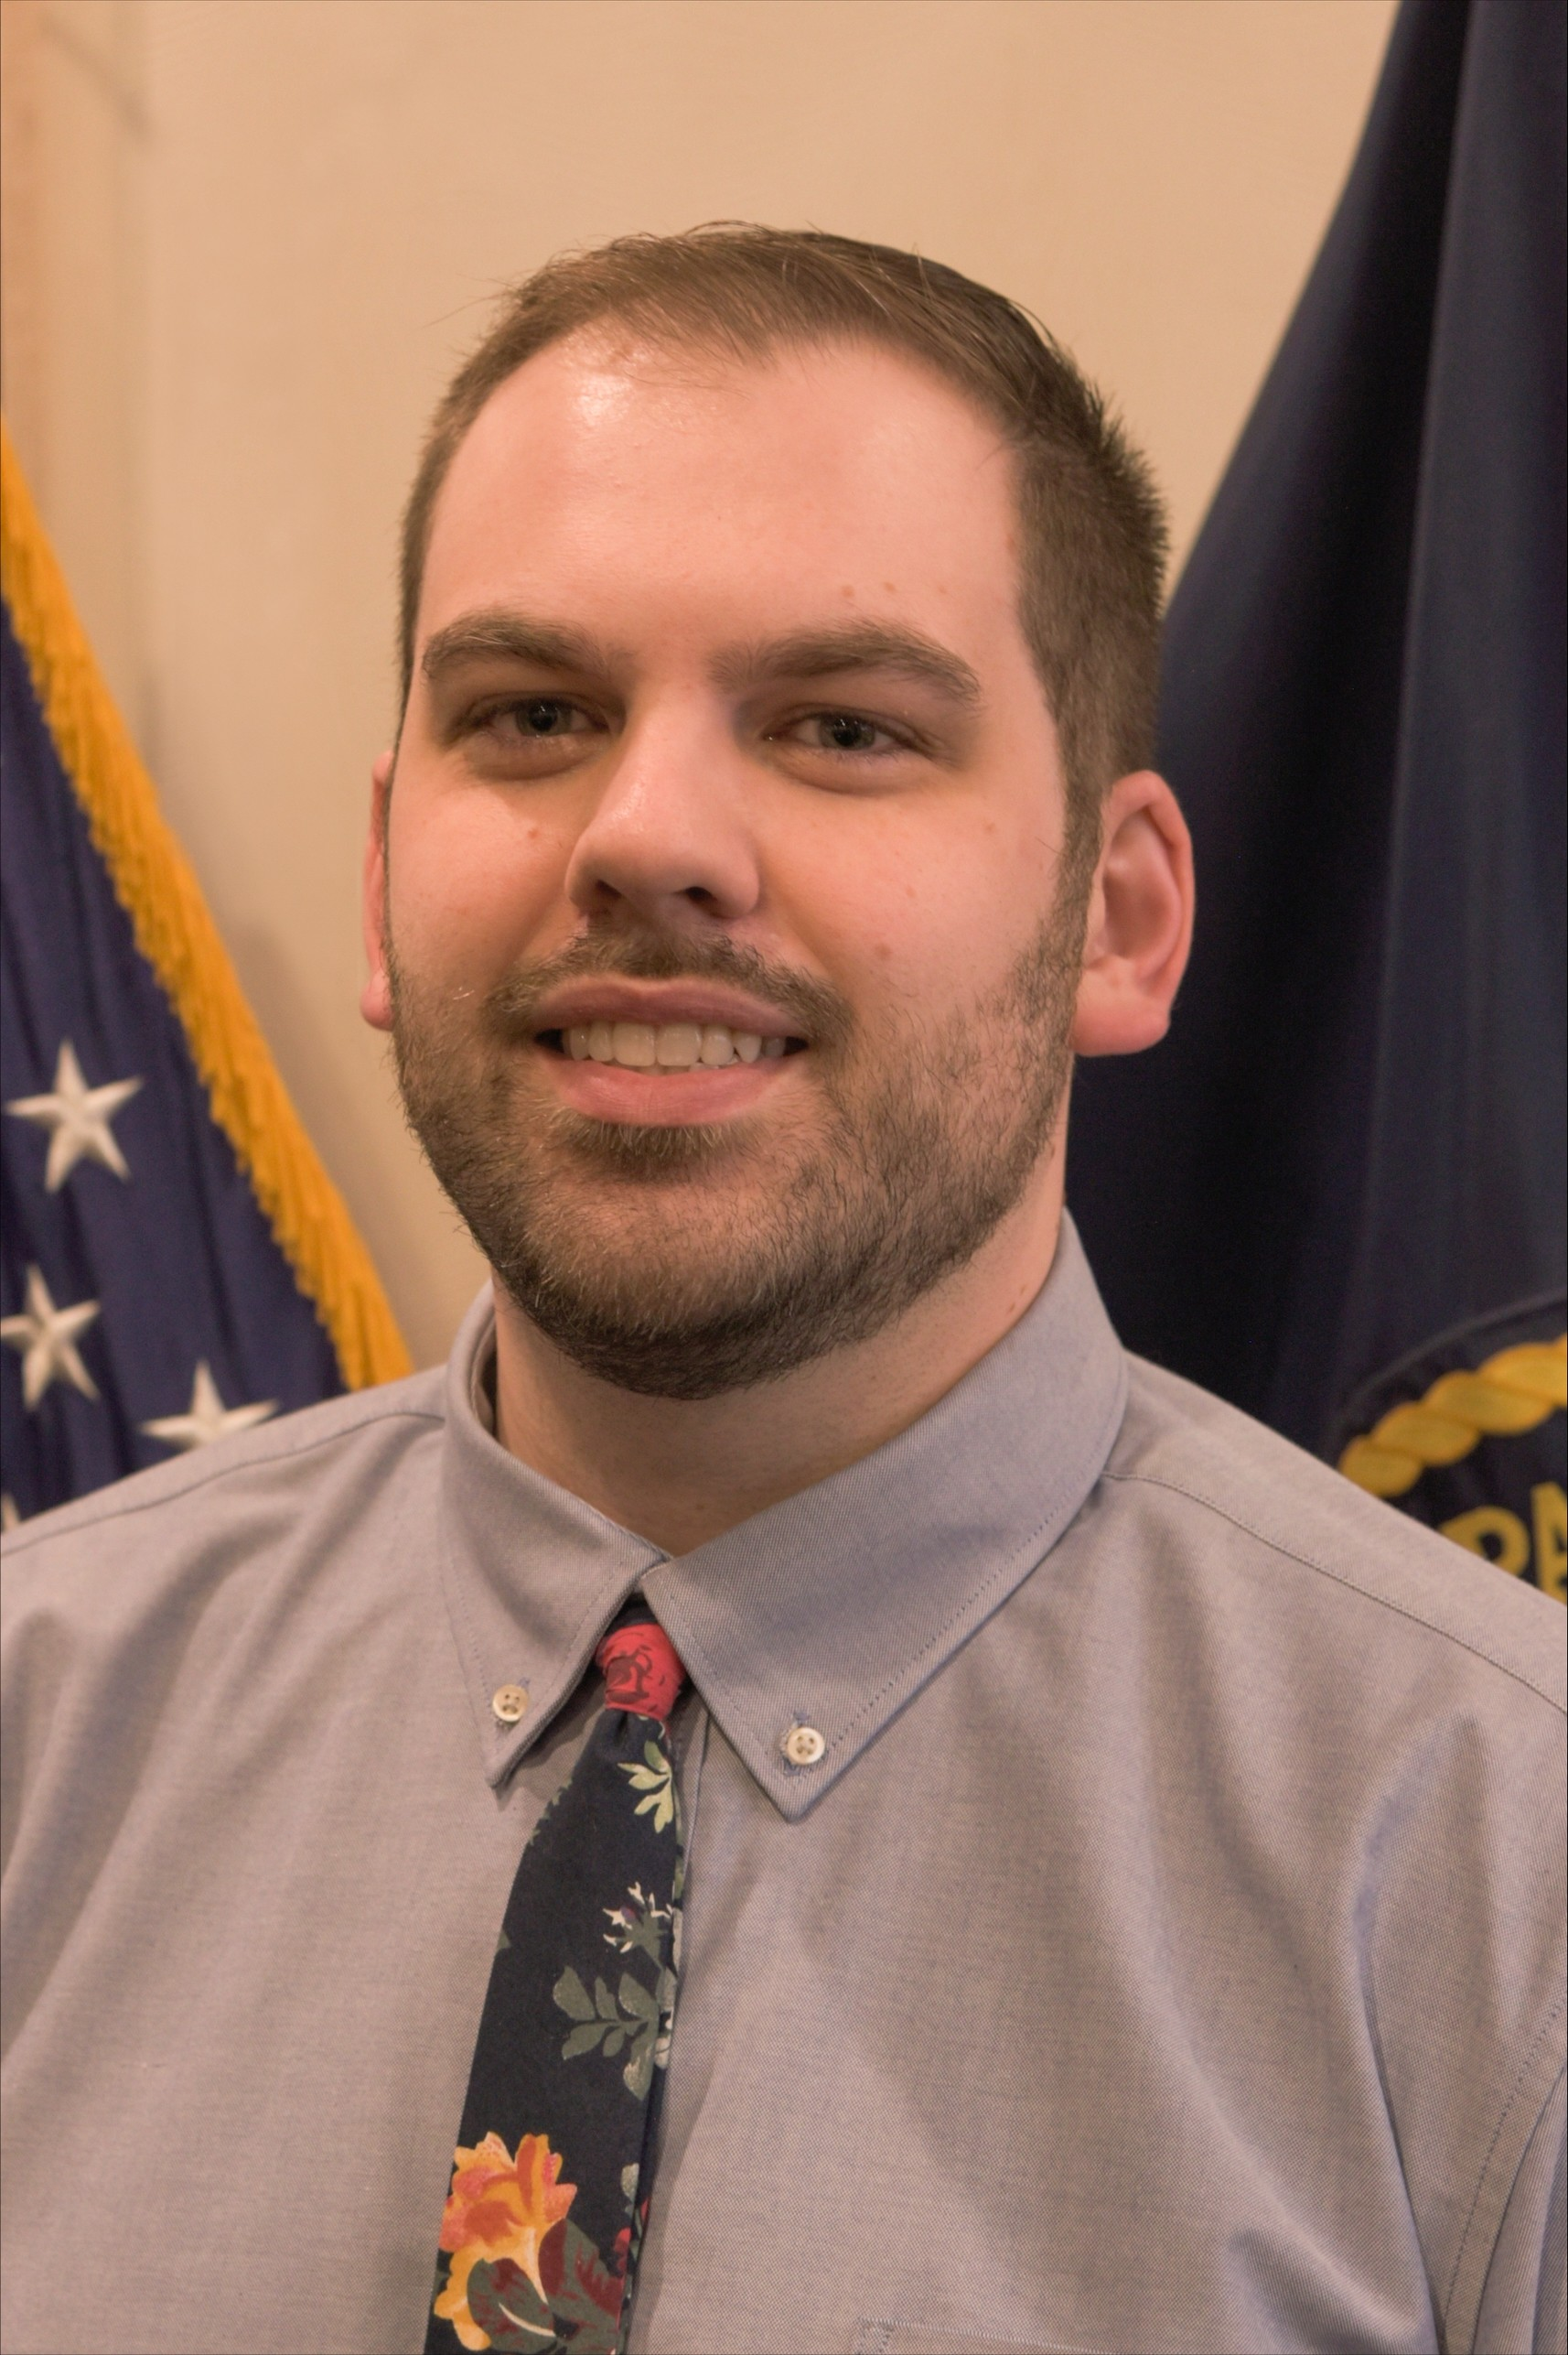


Employment Opportunities
Chief, Respiratory Therapy
VA Maryland Healthcare System, VHA
Mindy Conklin, MRT, RRT, RRT-ACCS
Advanced Practice Respiratory Therapist
VA Maryland Healthcare System, VHA
Daniel Thacker, MRT, RRT, RRT-ACCS
Advanced Practice Respiratory Therapist
VA Maryland Healthcare System, VHA
Notes:
While our clinical partners are ready to employ APRTs as soon as possible, licensure must happen first – more on that in a minute. However, the Veterans Health Administration has different rules and regulations related to requirements for practice. As a result, the VA Maryland Healthcare System currently employs two APRTs with a full scope of practice and the same privileges granted to other advanced practice providers within the VHA. This is the result of ground-breaking work by Daniel Whitt, who currently serves as the NBRC Vice-President and the Chief of Respiratory Therapy at the Maryland Healthcare System. He was aware of all the work happening related to creating the APRT profession, and he led the process of getting local support from physicians and administrators to create the employment opportunities within his hospital.

Slide 38
APRT Licensing in Ohio
OSRC Legislative Strategic Goals
Begin the process for creating an “advanced practice respiratory therapy” license with its own scope of practice, required education and examination in the State of Ohio. (2019-2020)
Develop draft language that would be supported or not-opposed by all stakeholders as we seek sponsorship, bill introduction, committee votes, House and Senate passage. (2021-2022)
Notes:
And speaking of the local legislative initiatives…

Slide 39
APRT Licensing in Ohio
Initial positive discussions with SMBO (July 2019)
Held Regional Forums in each OSRC district (November 2019 – January 2020)
Medical Directors, Pulmonologists, Critical Care, Sleep, Anesthesia… and RT managers/directors and staff
Held Formal Multi-disciplinary Collaborative Forums (June 2020-August 2020)
All stakeholders (APRNs, PAs, Nursing Board, Hospital Association, etc.) to discuss need, value, scope and develop draft language

Slide 40
Introduced December 2020

Slide 41
APRT licensing in Ohio
Made revisions based on professional organization feedback and SMBO feedback (2021)
Re-submitted to Legislative Services Commission for re-drafting (2022)

Slide 42


State Licensure
Bill introduced May 2, 2023!!
Search: Ohio House Bill 102 2023

Slide 43
APRT licensing in Ohio
(I) "Advanced practice respiratory therapist" means an individual who holds a current, valid license issued under this chapter that authorizes the practice of respiratory care as an advanced practice respiratory therapist.
(J) "Practice of respiratory care as an advanced practice respiratory therapist" means providing to individuals and groups care that requires knowledge and skill obtained from advanced formal education, training, and clinical experience. Such care includes the performance of services delegated by a supervising physician in the diagnosis and treatment of patients with cardiopulmonary diseases or conditions, including prescribing, ordering, procuring, dispensing, and administering drugs and medical devices.
Notes:
Some excerpts from the bill that are of interest to most people:
We have had two committee hearings, and are anxiously awaiting a third very soon. Just like the educational program approval and implementation process takes time – remember we started in 2012 with determining need and our program approval occurred in 2019 – the legislative process takes time.
The OSRC legislative committee is committed to moving the proposed legislation through the process as quickly as possible, and have worked diligently to make significant progress so far through discussions with legislative sponsors and interested parties.

Slide 44

Objectives
To describe the progression of the advanced practice respiratory therapist (APRT) as a new profession.
To describe curricular development considerations for an APRT education program.
To describe career development progression for APRT clinical practice.
Sarah Varekojis, PhD, RRT, RRT-ACCS, FNAP, FAARC
Varekojis.16@osu.edu
Notes:
Please feel free to contact me at the email address on the screen if you have additional questions. Thank you for spending some of your time with me today.

