Slide 1
Neonatal Golden Hour
Sara Maffeo-Jilani BS, RRT-NPS
Notes:
Welcome and good morning .

Slide 2
Disclosure Information
Sara Maffeo-Jilani
I have no actual or potential conflict of interest in relation to this presentation.
This presentation is intended to give you a brief window into the NICU Golden hour which is a multi step evidenced based approach designed for the care of newborns.
Notes:
My name is Sara Jilani but….. ( most people just call me respiratory; my other favorite nick name and most likely everyone here todays favorite nickname is “hey respiratory”). I am the Respiratory clinical educator for Golisano children's hospital of SWFL part of the Lee Health family.
I have no actual or potential conflict of interest in relation to this presentation.
This presentation is intended to give you a glimpse into the NICU Golden hour which is a multi step evidenced based approach designed for the care of newborns. Each part of this coordinated process is orchestrated, timed & reviewed making every birth a learning event.
I have some lovely assistants here today that are going to pass around a little packages so that you can visualize the difference between a micro preemie and a newborn baby.

Slide 3
How many of you have worked in a NICU ?
ⓘ Start presenting to display the poll results on this slide.
Notes:
Take your phones out we are going to try a little poll, Open your camera app and phone and scan the code ……
I also have some lovely assistants here today that are going to be passing around some little packets that have the diaper appropriate for a micro preemie and term size newborn . For those of you that do not work in NICU this just helps put into perspective the size and scope of the infants.

Slide 4
Learning Objectives
At the end of the program, the learner will:
Be familiar with a brief history of progression of care for the premature newborn and how the Golden Hour protocol became recognized as best practice.
Be instructed on the key Respiratory Care responsibilities during the Golden Hour .
Be able to conclude that by using the Golden Hour protocol, to support premature newborns, a transforming effect for the improved survival rates of newborns results.
Notes:
Let’s review our learning objectives :
Upon completion of this presentation the group will be familiar with a brief history of the progression of care for the newborn and how the Golden Hour protocol became recognized as best practice.
You will understand the key Respiratory Care responsibilities during the Golden Hour.
And finally, you will be confident that establishing standardized delivery care that focuses on Golden Hour protocols to support premature newborns, has a transforming effect for the improved survival rates of newborns.

Slide 5
Evolution of Care
A brief history of Neonatology
1880
1922
1952
1963
1969
1980’s
2000’s
France
Philadelphia &New York
New York
Washington & Boston
Palm Springs
USA
WORLDWIDE
Publication of first major American textbook devoted to the care of premature infants.
First published successful trial of surfactant treatment for RDS. NRP launched. High Frequency Ventilation.
Various quality improvement Initiatives have proven that coordination of care and provide a structured and systematic approach to decision making.
Introduction of “Incubator”, and gavage feedings.
Dr. Virginia Apgar devised a scoring system for rapid assessment of the clinical status of the newborn infant.
Patrick Bouvier Kennedy dies at 34 weeks and 2100g from hyaline membrane disease or “RDS”.
Baby Bird, first time cycled pressure limited ventilator for infants.
Notes:
In order to understand how we came to practice NICU golden hour and other protocols I need to give you a little history. As you can see Newborn care has come a long way since the 1800’s, there have been significant advancements and improvements made in the way infants are cared for. Back in the early 19th century, newborn care was very basic and often focused on ensuring the baby's survival. Today, newborn care is much more comprehensive, focusing on not just survival but also the overall health and well-being of the baby.
Each aspect of newborn care, from delivery practices to postnatal care, could be the subject of its own presentation. The evolution of newborn care is a fascinating topic this chart highlights the progress made.
The field of neonatology saw its most significant boom following the tragic deaths of the Kennedy babies in 1963, most importantly Patrick Bouvier Kennedy. Patrick's life and Death had a significant impact on the advancement of neonatal care and research for this country and the world. This heartbreaking event highlighted the urgent need for improved medical interventions and technology to support premature infants and prevent infant mortality. Patrick was a 34-week 2100-gram infant who was born with hyaline membrane disease or what we now call Respiratory distress syndrome. He was preceded in death, by his sister Arabella Kennedy who was still born.
In response to this public tragedy, the Kennedy family and the medical community launched a national campaign to raise awareness and funding for neonatal care. This led to increased research and investment in advancements such as specialized equipment, life-saving medications, and neonatal intensive care units (NICUs).
The Kennedy babies' deaths served as the catalyst for the development of new protocols and guidelines for the care of premature infants, driving improvements in medical practices and outcomes for preterm babies. There is always something to learn from tragic experiences even though we may not realize it at first. Neonatal care has made significant strides in improving survival rates and quality of life for premature infants worldwide. In 1963, an infant born prematurely with RDS at 34 weeks had a 95% chance of dying, but in 2024, that same infant has a 95% chance of survival.

Slide 6
13.4 million
2.4 million
1.8 million
Born prematurely
(World Health Organization , 2023)
Newborns who die within the first month of life.
Of those newborn deaths could be prevented with EB collaborative delivery care.
(Bennett, et al., 2016)
Notes:
According to the World Health Organization each year Globally 13.4 million infants are born prematurely , 2.4 million of these infants born prematurely die within the first month of life and 1.8 million of these deaths could be prevented with appropriate early interventional strategies.
Complications of resuscitation at birth can lead to increased morbidities for the newborn. Prolonged stabilization efforts and admission time can result in short and long-term problems for the infant.
One of the most common complications of resuscitation at birth is HIE or hypoxic-ischemic encephalopathy, which occurs when the baby's brain is deprived of oxygen and blood flow. This can lead to neurological deficits, developmental delays, and even cerebral palsy. Prolonged resuscitation efforts may also increase the risk of IVH intraventricular hemorrhage or periventricular leukomalacia, both of which can cause serious brain damage.
In addition to neurological complications, prolonged resuscitation and admission time can also lead to cardiovascular issues such as persistent pulmonary hypertension or cardiac arrhythmias. These conditions can have long-term effects on the baby's heart function and overall health.
Other potential complications of resuscitation at birth include respiratory distress syndrome, sepsis, and hypoglycemia. These conditions can require additional interventions and treatments, further increasing the risk of morbidity for the newborn.
Overall, it is crucial for healthcare providers to be aware of the potential complications of resuscitation at birth and to closely monitor newborns who require prolonged stabilization efforts. Early recognition, collaboration and appropriate management of these complications are essential in order to minimize the risk of long-term morbidities for the infant.
Focusing on the concept's collaboration & intervention :
The joint commission reports that ineffective communication and teamwork is the root cause for over 70% of Sentinel events.

Slide 7
A picture is worth a thousand words
Delivery Room Best Practice
Notes:
The first hour of life is a profound and critical time for ANY baby. An Infants risk of mortality is highest immediately after birth.
As neonatal care began to grow, the need for standardized neonatal resuscitation curriculums and strategies to ensure quality resuscitation and improve birth outcomes became evident.
In the late 70’s early 80’s The American Academy of pediatrics and the American Heart association collaborated to develop the first neonatal resuscitation program which aimed to have a skilled provider at every delivery.
Since then, the training programs have been instrumental in enhancing neonatal care, resulting in a significant reduction of mortality rates. There have been many updates and changes since that first training program. Around the release of the fifth edition in the early 2000’s NICU teams started to identify shortcomings in adherence to NRP guidelines. It was discovered that most of these issues were associated with teamwork and collaboration.
To address these issues NICU teams began to focus on prioritizing care practices that focus on comprehensive high-quality care. This approach ensures potential issues are identified and addressed early which leads to improved outcomes for newborns.

Slide 8
What is the golden hour?
Notes:
The NICU Golden hour refers to the initiation of treatment in a systematic, efficient manner in an effort to rapidly stabilize infants at birth. The First hour of life is a time of profound and critical adaption for any baby • Infant’s risk of mortality is at its highest immediately after birth • Studies suggest that management during this time period can have a significant impact on long term outcomes.

Slide 9
The 'Golden Hour' of neonatal life refers to the critical first hour following birth for both preterm and term neonates.
This concept, borrowed from adult trauma care where the first hour is known as the “Golden Hour”, emphasizes the importance of timely and evidence-based interventions such as thermoregulation glycemic control, and cardiorespiratory support for improving outcomes and reducing mortality rates in neonates.
Implementing these interventions within the first sixty minutes of life can have a significant impact on long-term health and survival rates.
Notes:
The 'Golden Hour' concept, is borrowed from adult trauma where the first hour is known as the “Golden Hour”.
The NICU golden hour emphasizes the importance of timely and evidence-based interventions such as thermoregulation, glycemic control, and cardiorespiratory support to significantly improve outcomes and reduce mortality rates in neonates.

Slide 10
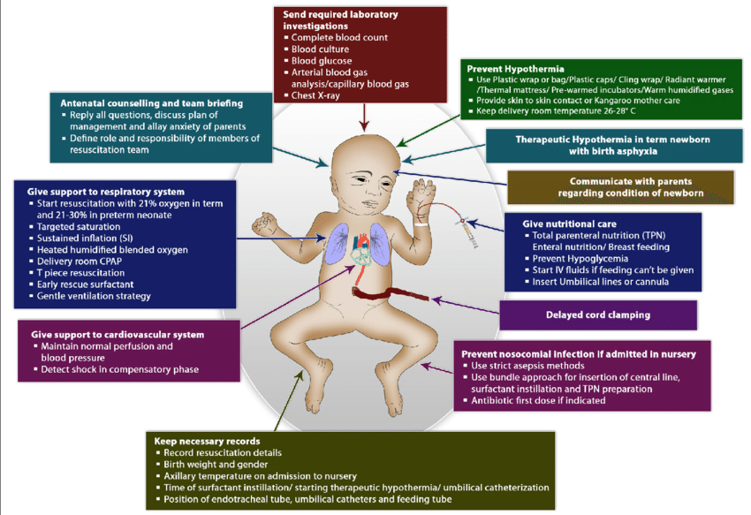
Golden Hour Interventions
Notes:
The NICU Golden HOUR protocol utilizes a team of healthcare professionals including neonatologists, nurses, respiratory therapists, and other specialists working together to create a seamless transition to extrauterine life.
There are several key components of the NICU golden hour that are essential:
First and foremost, immediate stabilization and assessment of the baby's condition. This includes monitoring vital signs, assessing breathing and heart rate, and making sure the baby is warm and comfortable.
The next crucial step is respiratory support. Premature infants often have underdeveloped lungs and may struggle to breathe on their own. The goal of respiratory support at delivery is to ensure the baby is receiving enough oxygen and ventilatory support to help them maintain a stable breathing pattern with the most minimally invasive mode of ventilation. There are several methods of respiratory support that healthcare providers may use in the NICU including continuous positive airway pressure (CPAP), high-flow nasal cannula therapy, non-invasive ventilation, mechanical ventilation often utilizing high frequency ventilation. The goal of any respiratory interventions in the NICU is lung protection.
Other important components of the NICU golden hour are establishing lines for IV fluids and medications, diagnostic tests, as well as screenings. Many premature babies require immediate support through IV fluids and medications to stabilize their condition and ensure they receive the necessary nutrients and medications to promote healthy growth and development.
The NICU team will also conduct various diagnostic tests and screenings to determine the baby's overall health status. This may include blood tests, X-rays, and other imaging studies to identify any underlying issues or complications that require immediate attention.
Additionally, following the conclusion of the golden hour sequence, NICU protocols dictate that minimal stimulation and testing be maintained for the initial 72-hour period. The NICU's focus during this critical time is on delivering emotional support and reassurance to the family of the newborn. Recognizing that the NICU experience can be daunting and anxiety-inducing for parents, it is imperative for the healthcare team to engage in effective communication, provide regular updates on the baby's health status, and offer a variety of resources to assist families in navigating the challenges associated with having a newborn in the NICU.
It is important for each NICU team to incorporate and regularly utilize simulation training to enhance and streamline practices that maximize the efficiency of their resources and algorithms.

Slide 11
Golden Hour Team Member Roles
Notes:
This is the current outline of roles and responsibilities utilized at Golisano during our golden hour protocol. You can see how clearly defined this agenda describes what each discipline should be focusing on during the 60-minute time frame.
Coordination of the team is essential. Utilizing the expertise of each discipline in the pre-brief, planning, interventions and debrief is essential to the implementation of successful golden hour protocol. Assigning the team and defining roles helps care become more coordinated and efficient. By working together as a cohesive team, health care providers can collaborate share insights and find ways to continuously improve outcomes for our tiniest and most vulnerable patients. This also ensures the team works together to seamlessly assure that all necessary assessments interventions and treatments are carried out promptly and effectively. Additionally having clear roles and responsibilities defined for each team member, creates the opportunity for potential areas for improvement to be identified, discussed, and implemented, leading to better outcomes for newborns.

Slide 12
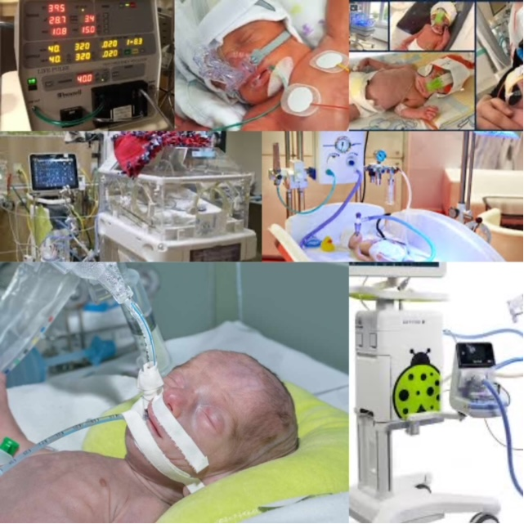
Respiratory Management
Notes:
Golden hour respiratory management utilizes gestational risk factors for respiratory compromise to develop a plan to assist infants in achieving normal gas exchange while minimizing the risk of lung injury.
Types of lung injury that typically arise include oxygen toxicity, volutrauma, barotrauma, and atelectasis. The objective is to adopt the least invasive and gentlest approach that elicits a response from the infant, with intubation only being considered, if necessary, based on gestational age or clinical presentation.
Ideally, efforts should focus on promoting spontaneous breathing and utilize positive pressure to establish and maintain functional residual capacity (FRC).
It is essential that respiratory support in the NICU remains flexible and responsive to the changing needs of the infant. Support should be provided based on the individual requirements of each infant.

Slide 13
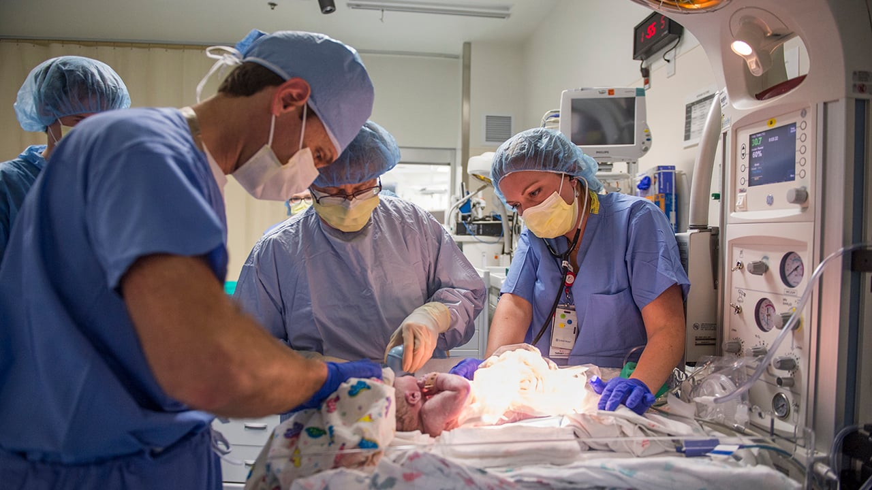
Respiratory' s Role in Golden Hour Management
Notes:
Respiratory therapists play a crucial role in the Golden Hour process.
The expertise of RT’s are essential in resuscitating newborns who may be experiencing breathing difficulties or respiratory distress at birth.
RT responsibilities include :
evaluating and managing the baby's respiratory status.
Assessing the infants breathing, oxygen levels, and lung function to ensure adequate oxygenation and ventilation.
Providing respiratory support through interventions such as supplemental oxygen therapy, continuous positive airway pressure (CPAP), intubation or mechanical ventilation.
Rt’s are considered “airway experts”. Because we all know When you can't breathe nothing else matters.
In the delivery room and NICU, respiratory distress is the number one cause of death and complications.
so, Establishing the airway and adequately supporting respiration is the key to stabilizing an infant and therefore the main priority.

Slide 14
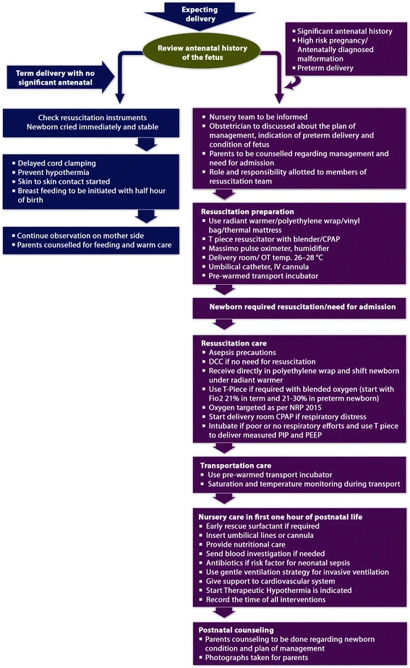
Notes:
Various protocols have been established to guide care in both the delivery room and the Neonatal Intensive Care Unit (NICU).
Enhancing adherence to resuscitation algorithms, such as implementing the golden hour protocol, is essential in reducing neonatal mortality rates and minimizing long-term complications in NICU patients. The golden hour protocol utilizes: Resuscitation training programs, frequent simulation exercises, clinical decision support, and post-event reflection to enhance clinical practice and performance.
Implementing strategies that turn each birth into a learning opportunity have the potential to address proficiency gaps in newborn resuscitation that may persist despite training and simulation practices. It is crucial for NICU’s to prioritize further development and evaluation of golden hour protocols and algorithms.

Slide 15
Golden Hour-Take Aways
Team
Delivery Room Management
Pre-brief/Preparation
Collaboation is essential.
Having a dedicated, highly skilled team is essential.
Standardization of the delivery room procedure, utilizing checklists, assigning roles, and colleceting data.
Preparing for and anticipating high risk deliveries.
Family Centered &Developmentally Focused
Debriefing
Practice makes Perfect
Include families.
Promote an environment tht promotes optimal and short term outcomes.
Reflection and discussion improves clinical outcomes .
Improves clinical reasoning and enhances knowledge and skills.
Notes:
In conclusion , Collaboration among team members in the NICU is important to effectively implement the Golden Hour protocols. The management of the delivery room requires the coordination of healthcare professionals to ensure a smooth transition for the newborn. Pre-briefing allows team members to discuss the plan of care before the baby arrives, promoting a well-coordinated approach. Family-centered care emphasizes the involvement of the family in the care and decision-making process, while developmentally focused care aims to address the individual needs of each infant. Debriefing after the Golden Hour enables the team to review the care provided and identify areas for improvement in future cases. Simulation provides a valuable opportunity to practice and enhance skills in a controlled setting, preparing for real-life situations. Altogether, these elements contribute to delivering the best possible care for infants in the NICU during the critical Golden Hour period.

Slide 16
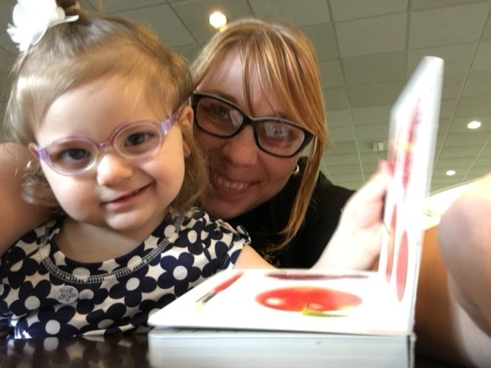
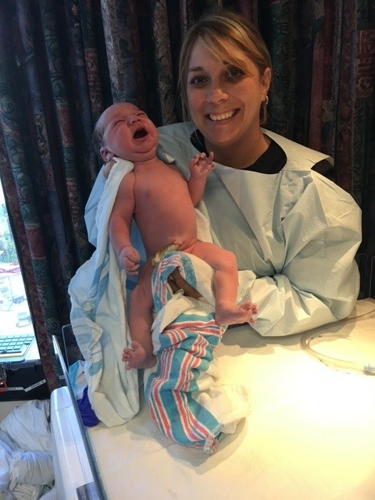
This RT in her natural habitat
These photos are used with permission from the patients and their families.
Emmylou
Ariah
Nicholas
Notes:
Before I depart, I would like to share some success stories of some Rockstar NICU GRADS Emmylou is 9 , Ariah will be 8 this year and Nicholas just turned 7 and impart one final thought.
While it is possible for women to have healthy pregnancies,… the United States still lags behind many developed nations in terms of birth safety. 1 in 10 babies is born prematurely each year in the US. The Centers for Disease Control and Prevention (CDC) and the Office of Disease Prevention and Health Promotion are actively engaged in initiatives aimed at improving healthcare for women and infants in our country.
What can we do to make a difference? We can support funded programs that improve health care services and systems for ALL, participate in research initiatives, and join organizations that fund research to enhance the health of women and children. And Additionally, promote early intervention strategies in our communities that can help make a positive impact.

Slide 17
Notes:
And on that final note , that concludes my presentation . I want to express my sincere gratitude for your time and attention. Please remember to take care of yourself and each other.
We have a few minutes; Does anyone have any questions?

Slide 18
References
Administration, H. R. (2024, January ). How can we improve Maternal Health. Retrieved from Health Resources & Services Administration: https://www.hrsa.gov/maternal-health
American Academy of Pediatrics . (2024, 01 17). NRP History . Retrieved from American Academy of Pediatrics : https://www.aap.org/en/pedialink/neonatal-resuscitation-program/nrp-history/.
Association, A. H. (2021). Textbook of Neonatal Resuscitation (8 ed.). Itesca, IL: American Academy of Pediatrics.
Bennett, S., Finer, N., Halamek, L., Mickas, N., Bennett, M. V., Nisbet, C., & Sharek, P. (2016). Implementing Delivery Room Checklists and Communication Standards in a Multi-Neonatal ICU Quality Improvement Collaborative. Joint Commission Journal on Quality and Patient Safety, 369-76. doi: 10.1016/s1553-7250(16)42052-0.
Bettinger, K., Mafuta, E., Mackay, A., Bose, C., Myklebust, H., Haug, I., . . . Patterson, J. (2021). Improving Newborn Resuscitation by making Every Birth a Learning Event. Children (Basel), 12, 8. doi: 10.3390/children8121194.
Castrodale, V. M.-B., & Rinehart, S. R.-N. (2014). The Golden Hour Improving the Stabilization of the Very Low Birth Weight Infant. National Association of Neonatal Nurses, 14(1), 9-14. doi:10.1097/ANC.0b013e31828d0289.
Dingley, C. R., Daugherty, K. R., Derieg, M. K., & Persing, R. R. (2008, August). Improving Patient Safety Through Provider Communication Strategy Enhancements. 3, 18. (A. f. Research, Ed.) Rockville, MD, USA.
Lambeth, T. M.-B., Rojas, M. A., Holmes, A. P., & Dail, R. B. (2016). First Golden Hour of Life- A quality Improvement Initiative. Clinical Issues in Neonatal Care, 264-273. doi:10.1097/ANC.0000000000000306.
Prevention, C. f. (2022, January ). Maternal and Infant Health . Retrieved from Reproductive Health: https://www.cdc.gov/reproductivehealth/maternalinfanthealth/index.html
Reynolds, R. R.-N., Pilcher, J. R.-N., Ring, A. R.-N., Johnson, R. R.-N., & Mckinley, P. R. (2009). The Golden Hour Care of the LBW Infant During the First Hour of Life One Unit's Experience. Neonatal Network, 28(4), 211-219.
Ryan, M. S.-N. (2015). Patrick Bouvier Kennedy A Brief Life that changed the History of Newborn Care. Minneapolis, MN: MCP Books.
Services, U. D. (2024, January ). Healthy People 2030. Retrieved from Increase the proportion of pregnant women who receive early and adequate prenatal care — MICH 08: https://health.gov/healthypeople/objectives-and-data/browse-objectives/pregnancy-and-childbirth/increase-proportion-pregnant-women-who-receive-early-and-adequate-prenatal-care-mich-08/data
Sharma, D. (2017). Golden hour of neonatal life: Need of the hour. Maternal Health, Neonatology and Perinatology(3), 16. doi:10.1186/s40748-017-0057-x.
K.Walsh , B. (2023). Neonatal and Pediatric Respiratory Care (6 ed.). Philadelphia, PA: Elsevier.
World Health Organization . (2023, May 10). Preterm Birth. Retrieved from World Health Organization : https://www.who.int/news-room/fact-sheets/detail/preterm-birth.

